Slide 1
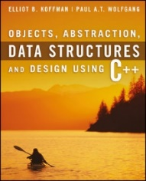
Welcome to
CS 235 Data Structures
Trees (Heaps) (28)
Chapter 8.5, pgs. 484-496

Slide 2
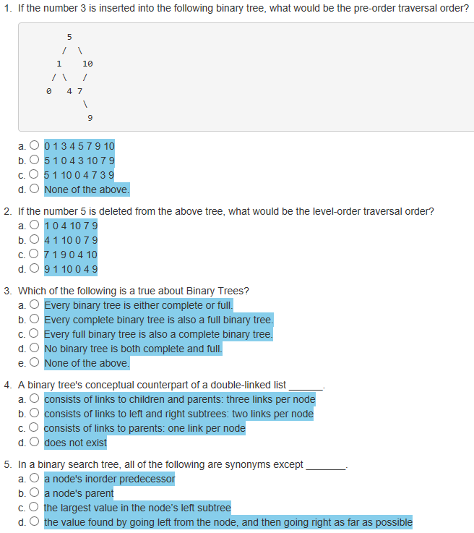
Attendance Quiz #27

Slide 3
Tip #28: Initialization Lists
Initialization rules are fickle:
int x[10]; // values are NOT initialized
vector<int> x; // vector is fully initialized
The best way to deal with this this seemingly indeterminate state of affairs is to always initialize your objects before you use them!
The responsibility for initialization falls on the constructors.
The rule: make sure that all constructors initialize everything in the object!
But, don't confuse assignment with initialization!
Initialization is creating an instance (of type) with certain value.
Assignment is to give value to an already created instance (of type).
Construct name with an object value representing an empty string.
Then assign to this already initialized variable the value s.
Construct name with an object value of variable s (constructors will be called once.)
class Person
{
private:
string name;
public:
Person(string s)
{ this->name = s; }
};
class Person
{
private:
string name;
public:
Person(string s) : name(s)
{ }
};

Slide 4
Delete
bool delete(Node*& node, const T& data)
if node is NULL, return false
if data < node->data, return delete(node->left, data)
if data > node->data, return delete(node->right, data)
if node has no children, parent = NULL, return true
if node has 1 child, parent = node->(left or right), return true
exchange node->data with in_order_predecessor->data
return delete(node->left, data)
8
8
8
8
8
8
8
Delete node 2
Find node (2)
Set parent (3) to child (1)
8
3
3
3
3
9
9
9
3
9
3
3
3
9
9
9
9
2
2
2
2
4
4
4
2
5
2
2
1
4
4
4
5
12
12
12
12
12
12
12
12
1
11
11
11
11
11
11
11
4
11
4

Slide 5
Delete
bool delete(Node*& node, const T& data)
if node is NULL, return false
if data < node->data, return delete(node->left, data)
if data > node->data, return delete(node->right, data)
if node has no children, parent = NULL, return true
if node has 1 child, parent = node->(left or right), return true
exchange node->data with in_order_predecessor->data
return delete(node->left, data)
5
8
8
8
8
8
5
8
Delete node 2
Find node (2)
Set parent (3) to child (1)
8
3
3
3
3
3
3
3
3
9
9
9
9
9
9
9
Swap data
9
Delete node 8
Find predecessor (5)
Exchange data only with node
Delete 8 from left tree
2
2
2
2
2
1
2
1
4
4
4
4
4
4
4
5
8
12
12
12
12
12
12
12
12
11
11
11
11
11
11
11
4
11

Slide 6
Delete node 8
Delete node 17
8
12
6
4
Swap data
12
4
22
2
6
2
17
8
1
5
7
1
16
20
Delete node 40
Delete node 40
40
40
4
45
4
45
3
34
42
55
3
20
42
55
14
48
75
15
34
48
13
15
47
49
25
47
49

Slide 7
Lab 08 - BST

Slide 8
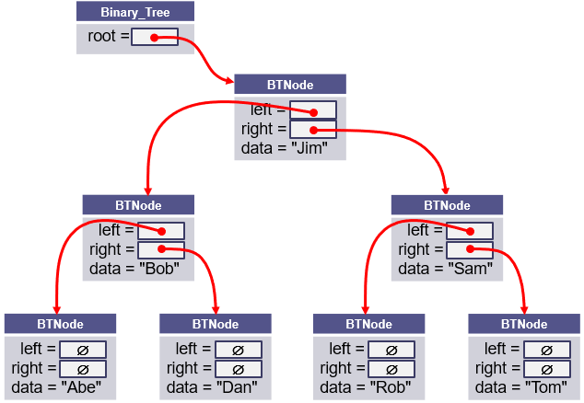
L08 – Binary Search Tree
A binary search tree (BST), which may sometimes be called an ordered or sorted binary tree, is a node-based data structure where each node references a value, a left child, and a right child.
In a Binary Search Tree, the left subtree of a node contains only nodes with values less than the node's value, the right subtree of a node contains only nodes with values greater than the node's value, there are no duplicate nodes, and both left and right subtrees of a node must also be binary search trees.

Slide 9
BST Commands
COMMAND | DESCRIPTION | OUTPUT
INT | Instantiates a BST object for subsequent commands. | OK, Error
STRING | Instantiates a BST object for subsequent commands. | OK, Error
add <data> | Add data node to BST. Return false if duplicate. | OK, Error
remove <data> | Remove node from BST. Return false if not found. | OK, Error
clear | Delete all nodes from the BST. | OK
print | Print BST (using insertion operator) in level-order. | Level-order list, empty
copy | Make deep copy of BST. | OK
printcopy | Print BST (using insertion operator) in level-order. | Level-order list, empty
size | Output the number of nodes in the BST. | Number of BST nodes
find <data> | Find and display node in BST. | found, not found
tree (Bonus) | Output the contents of the BST using begin() and end() iterators in in-order. | In-order listing of BST.

Slide 10
Level-Order Traversal
/** Output nodes at a given level */
bool outLevel(Node<T>* root, int level, stringstream& out) const
{
if (root == NULL) return false;
if (level == 0)
{
out << " " << root->data;
if ((root->left != NULL) || (root->right != NULL)) return true;
return false;
}
if ((level == 1) && !root->left_ && root->right_) out << " _";
bool left = outLevel(root->left, level - 1, out);
bool right = outLevel(root->right, level - 1, out);
if ((level == 1) && root->left_ && !root->right_) out << " _";
return left || right;
} // end outLevel()
int level = -1;
do
{
out << endl << " " << ++level << ":";
} while (outLevel(root, level, out));
Add 2 True
Add 3 True
Add 4 True
PrintBST
0: 2
1: _ 3
2: _ 4

Slide 11
BST Grading Criteria
Points | Requirement (50 + 10)
15 | BST commands "INT" and "STRING" set the BST template type mode to int and string respectively. BST command "add" adds an int or string element to the BST. (Attempt to add a duplicate node outputs False.) BST command "print" outputs the BST in level order. (If the BST is empty, output "Empty".) (lab08_in_01.txt)
5 | BST commands "size" and "clear" are correctly implemented for types int and string. (lab08_in_02.txt)
10 | Nodes are correctly removed from the BST using the "remove" command. (Attempt to remove a non-existent node outputs False.) (lab08_in_03.txt)
10 | The BST "find" command outputs "Found" if the value is in the BST and "Not Found" if the node is not found. (lab08_in_04.txt)
10 | The BST "copy" command makes a deep copy of the current BST. BST command "printcopy" outputs the deep BST copy in level order. (lab08_in_05.txt)
-10 | Memory leaks, array out-of-bounds, or use of STL container detected.
10 | BONUS: The "tree" command displays the tree in in-order using BST iterators. (If the BST is empty, output "Empty".) (lab07_in_06.txt)
2 | A BST class is derived from the abstract BSTInterface interface class.
2 | All classes have public toString and friend insertion member functions
2 | BONUS: The bonus "tree" command is implemented using an iterator implemented as a BST inner class with ++, *, and != operators. The BST class has public begin() and end() functions that return instantiated iterators.

Slide 12
BST Class
#include "BSTInterface.h"
template<typename T>
class BST : public BSTInterface<T>
{
private:
struct Node
{
T data_;
Node* left_;
Node* right_;
Node(const T& d) : data_(d), left_(NULL), right_(NULL) { }
};
Node* root_;
public:
BST() { this->root_ = NULL; }
~BST() { clearTree(); }
/** Return true if node added to BST, else false */
virtual bool addNode(const T& data) { return insert(this->root_, data); }
/** Return true if node removed from BST, else false */
virtual bool removeNode(const T& data) { return remove(this->root_, data); }
/** Return true if BST cleared of all nodes, else false */
virtual bool clearTree() { return deleteTree(root_); }
/** Return a level order traversal of a BST as a string */
virtual string toString() const { ... }
/** Override insertion operator to insert BST string */
friend std::ostream& operator<< (ostream& os, const BST<T>& bst) { ... }
};
Class BST inherits from the interface template BSTInterface class.
structs are lightweight objects and often used in place of a class if the object's main responsibility is a type of data storage. A node represents a single value, is similar to a primitive type, is mutable, and relatively small, and hence a good candidate for a struct

Slide 13
Iterator (Bonus)
#include "BSTInterface.h"
template<typename T>
class BST : public BSTInterface<T>
{
private:
struct Node { ... };
Node* root_;
public:
BST() { this->root_ = NULL; }
~BST() { clearTree(); }
/** BST iterator */
class Iterator
{
private:
mutable int index_;
Node* root_;
public:
Iterator(int index, Node* root) : index_(index), root_(root) {}
~Iterator() {}
virtual bool operator!=(const Iterator& rhs) const { ... }
virtual Iterator operator++(T) { ... }
virtual T operator*() const { ... }
};
virtual Iterator find(T& value) { ... }
virtual Iterator begin() { ... }
virtual Iterator end() { ... }
};
if (item1 == "Find")
{
out << endl << "Find " << data;
BST<int>::Iterator iter = bst.find(data);
BST<int>::Iterator end_iter = bst.end();
if (!(iter != end_iter)) out << " Not Found";
else out << " Found " << *iter;
}
else if (item1 == "Tree")
{
out << endl << "Tree ";
BST<int>::Iterator iter = bst.begin();
BST<int>::Iterator end_iter = bst.end();
if (iter == end_iter) out << " Empty";
for (; iter != end_iter; iter++)
out << " " << *iter;
}
BST
Iterator
Nested classes can access all members of the parent via a reference/pointer

Slide 14
Iterator
BST<int>
Node* root_;
8
8
8
Iterator
int index_ = 0; Node* root_;
begin()
5
3
3
3
3
9
9
9
9
Iterator
int index_ = 7; Node* root_;
2
2
2
1
4
4
4
4
12
12
12
12
end()
11
11
11
11
BST<int>::Iterator iter = bst.begin();
BST<int>::Iterator end_iter = bst.end();
if (iter == end_iter) out << " Empty";
for (; iter != end_iter; iter++)
out << " " << *iter;
?

Slide 15
Copying Objects
Applications require that a copy of an object be an independent copy, which means being able to modify one of the objects without affecting the other.
Copying of primitive types is straightforward—the values are duplicated and placed in the target locations (shallow).
If the object references a dynamically allocated object, the memory allocated to that object must be freed (deep).
The Gang of Three Rule basically states that if a class defines one (or more) of the following, it should probably explicitly define all three:
Copy constructor – create new object members from corresponding member constructors.
Copy assignment operator – assign corresponding members from existing members.
Destructor – call the destructors of all the object's class-type members.
The default constructors and assignment operators only do shallow copies.
Destructors contain code that is run whenever an object is destroyed.
An explicit deep copy constructor, assignment operator, and destructor must be created when a class contains pointers to dynamically allocated resources.

Slide 16
Copy Constructor / Assignment Operator
To create an independent copy of an object, the
Copy constructor is called when a new object is created from an existing object:
MyClass t1; // default constructor
MyClass t2 = t1; // copy constructor (t2 is new)
Assignment operator is called when an already initialized object is assigned a new value from another existing object.
t2 = t1; // assignment operator (t2 exists)
t2.operator=(t1); // assignment operator (equivalent)
Examples:
BST<int> bst1; // default constructor of bst1
BST<int> bst2(bst1); // copy constructor of bst1
bst2 = bst1; // assignment operator
The copy constructor is invoked automatically:
when an object is passed to a function by value.
when an object is returned from a function.
when an object is initialized with another object of the same class.
when the compiler generates a temporary object.

Slide 17
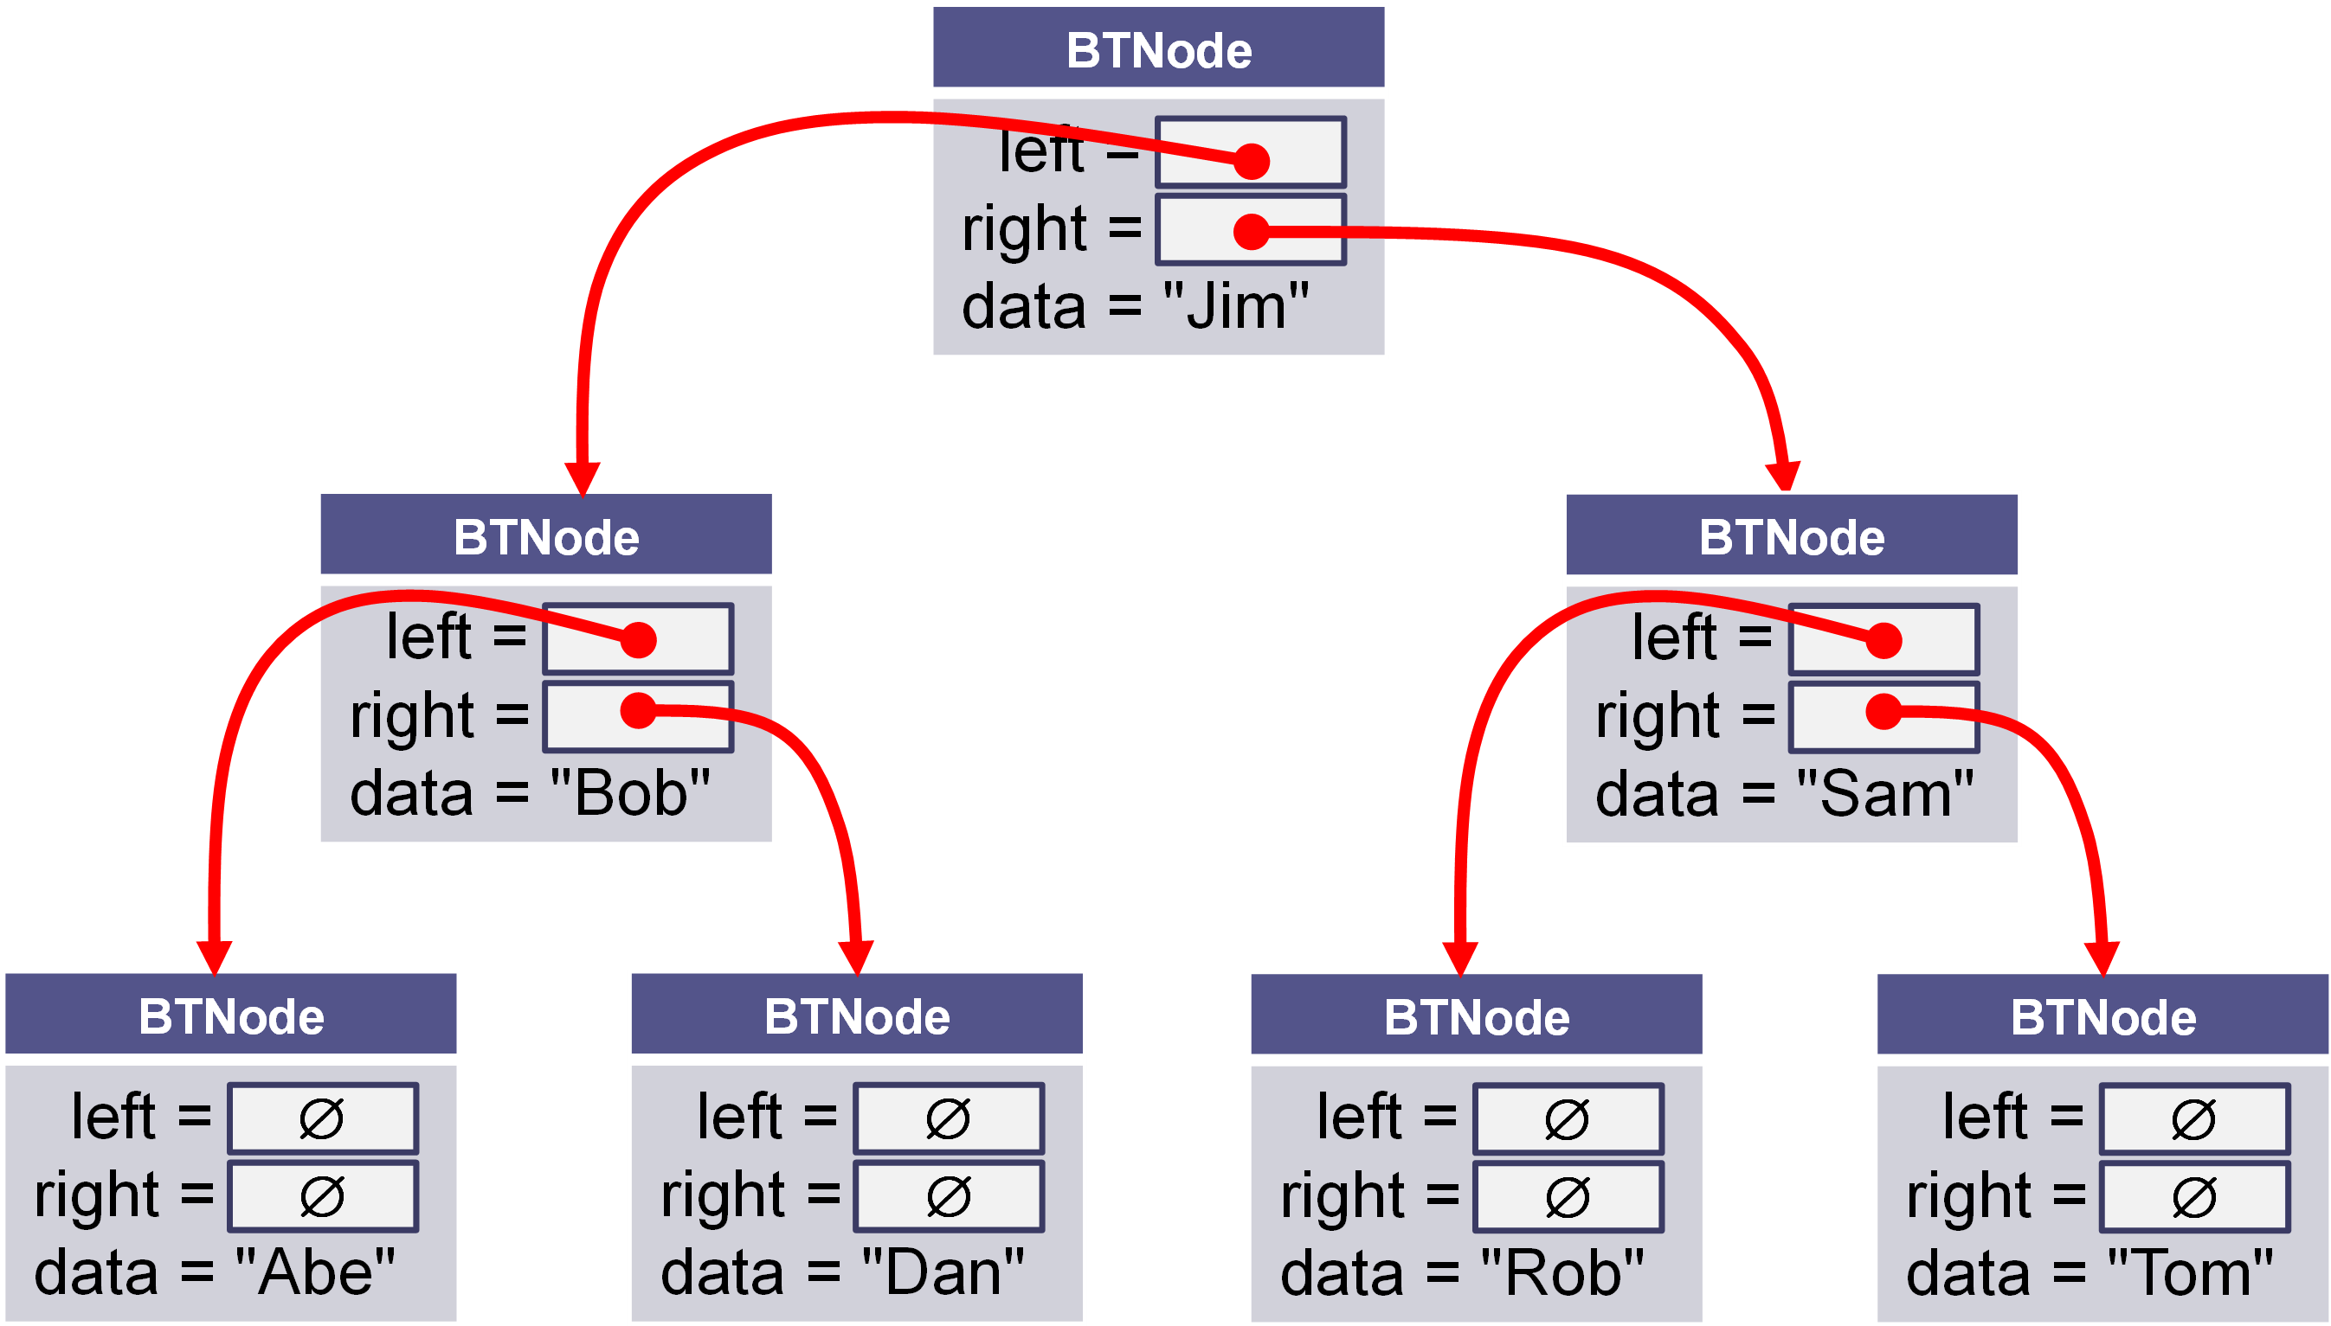
Shallow vs Deep Copy
Copying size and root fields create independent copies of the variables but not independent copies of the BST tree nodes.
Copying a pointer this way is considered a shallow copy.
We need to create an independent copy or a deep copy of the underlying array so that bst1.root and bst2.root point to different trees, making bst2 a deep copy of bst1.
BST<int> bst1
size_ = 7 int* root_ =
BST<int> bst2
size_ = 7 int* root_ =

Slide 18
Copy Constructor
/** Deep copy constructor.
@param bst The BST to be copied
@return This BST with a new copy of the bst's contents
*/
BST<T>(const BST<T>& bst) : root_(NULL), size_(0)
{
// recursively copy nodes from bst to this bst.
copyNode(bst.root_);
}
BST<int> bst1;
BST<int> bst2(bst1);
this
bst
Construct a new BST<T> (*this).
Recursively copy nodes from bst to the new BST.

Slide 19
Assignment Operator
/** Assign the contents of one BST to another.
@param other The BST to be assigned to this BST
@return This BST with a copy of the other BST's contents
*/
BST<T>& operator=(const BST<T>& rhs)
{
// Make a copy of the rhs BST.
BST<T> the_copy(rhs);
// Swap this' root with the_copy root.
swap(this->root, the_copy.root);
// Return self (the copy will be deleted)
return *this;
}
BST<int> bst1;
BST<int> bst2(bst1);
bst2 = bst1;
this
other
Make a deep copy of rhs (rhs → the_copy)
Exchange *this and the_copy elements only (*this ←→ the_copy)
Return *this and
Delete the_copy (destructor)

Slide 20
The Destructor
The purpose of the destructor is to undo what the constructor does.
The constructor takes a block of uninitialized memory and sets it to a valid state, thus creating an object.
When the destructor is finished, the object is in an invalid state and the memory it occupies can be reused for creating other objects.
If this is not done, the program will have memory leaks.
Each class has a default destructor, which effectively invokes the destructor for each data field.
If the pointer references a dynamically allocated object (such as the BST nodes referenced by pointer root), the memory allocated to that object must be freed!

Slide 21
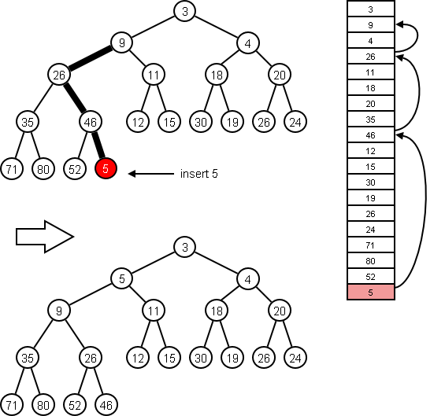
8.5 Heaps and Priority Queues
Inserting an Item into a Heap
Removing an Item from a Heap
Implementing a Heap
Priority Queues
The priority_queue Class
Using a Heap as the Basis of a Priority Queue
8.5, pgs. 484-495

Slide 22
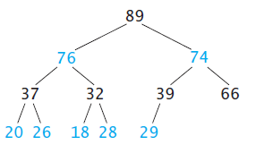
Heaps
A heap is a complete binary tree with the following properties:
The value in the root is greater than or equal to any item in the tree (max-heap.)
Every subtree is a heap.

Slide 23
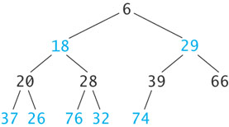
Min Heap
In a max-heap, each node’s value is larger than or equal to the values of its children, and the root node stores the largest value.
The heap shown below is called a min-heap because the root node stores a smallest value.
The text presents algorithms and illustrations for max heaps.
Here we present the corresponding algorithms and illustrations for min heaps.

Slide 24
Inserting an Item into a Min-Heap
6
18
29
20
28
39
66
37
26
76
32
74
89

Slide 25
Inserting an Item into a Min-Heap
6
18
29
20
28
39
66
37
26
76
32
74
89
8

Slide 26
Inserting an Item into a Min-Heap
6
18
29
20
28
39
8
37
26
76
32
74
89
66

Slide 27
Inserting an Item into a Min-Heap
6
18
8
20
28
39
29
37
26
76
32
74
89
66

Slide 28
Inserting an Item into a Min-Heap
6
18
8
20
28
39
29
37
26
76
32
74
89
66

Slide 29
Removing an Item into a Min-Heap
6
18
8
20
28
39
29
37
26
76
32
74
89
66

Slide 30
Removing an Item from a Heap
6
18
8
20
28
39
29
37
26
76
32
74
89
66

Slide 31
Removing an Item from a Heap
66
18
8
20
28
39
29
37
26
76
32
74
89

Slide 32
Removing an Item from a Heap
8
18
66
20
28
39
29
37
26
76
32
74
89

Slide 33
Removing an Item from a Heap
8
18
29
20
28
39
66
37
26
76
32
74
89

Slide 34
Removing an Item from a Heap
8
18
29
20
28
39
66
37
26
76
32
74
89

Slide 35
8
34
12
Insert 3 into the min-heap.
49
36
20
14
77
51
65
87
29
66
8
34
42
Remove a node from the min-heap.
49
36
50
84
77
51
65
87
52
71

Slide 36
Implementing a Min-Heap
Because a heap is a complete binary tree, it can be implemented efficiently using an array rather than a linked data structure.
For a node at position p with an array,
The left child's position is 2p + 1.
The right child's position is 2p + 2.
A node at position c in the array can find its parent at
floor((c – 1) / 2).
The root is found at index 0.
NOTE: most implementations use index 0 as the size of the heap and put the root at index 1 – the book does not.
The array representation is a level order traversal of the binary tree.

Slide 37
Implementing a Min-Heap
8
8
29
18
29
18
28
28
39
39
66
20
66
20
37
37
26
26
76
76
32
32
74
74
89
89
0 | 1 | 2 | 3 | 4 | 5 | 6 | 7 | 8 | 9 | 10 | 11 | 12 | 13
8 | 18 | 29 | 20 | 28 | 39 | 66 | 37 | 26 | 76 | 32 | 74 | 89

Slide 38
Implementing a Min-Heap
For a node at position p, L. child position: 2p + 1
R. child position: 2p + 2
8
18
29
20
28
39
66
37
26
76
32
74
89
0 | 1 | 2 | 3 | 4 | 5 | 6 | 7 | 8 | 9 | 10 | 11 | 12 | 13
8 | 18 | 29 | 20 | 28 | 39 | 66 | 37 | 26 | 76 | 32 | 74 | 89
Parent
L. Child
R. Child

Slide 39
Implementing a Min-Heap
For a node at position p, L. child position: 2p + 1
R. child position: 2p + 2
8
18
29
20
28
39
66
37
26
76
32
74
89
0 | 1 | 2 | 3 | 4 | 5 | 6 | 7 | 8 | 9 | 10 | 11 | 12 | 13
8 | 18 | 29 | 20 | 28 | 39 | 66 | 37 | 26 | 76 | 32 | 74 | 89
Parent
L. Child
R. Child

Slide 40
Implementing a Min-Heap
For a node at position p, L. child position: 2p + 1
R. child position: 2p + 2
8
18
29
20
28
39
66
37
26
76
32
74
89
0 | 1 | 2 | 3 | 4 | 5 | 6 | 7 | 8 | 9 | 10 | 11 | 12 | 13
8 | 18 | 29 | 20 | 28 | 39 | 66 | 37 | 26 | 76 | 32 | 74 | 89
Parent
L. Child
R. Child

Slide 41
Implementing a Min-Heap
For a node at position p, L. child position: 2p + 1
R. child position: 2p + 2
8
18
29
20
28
39
66
37
26
76
32
74
89
0 | 1 | 2 | 3 | 4 | 5 | 6 | 7 | 8 | 9 | 10 | 11 | 12 | 13
8 | 18 | 29 | 20 | 28 | 39 | 66 | 37 | 26 | 76 | 32 | 74 | 89
Parent
L. Child
R. Child

Slide 42
Implementing a Min-Heap
For a node at position p, L. child position: 2p + 1
R. child position: 2p + 2
8
18
29
20
28
39
66
37
26
76
32
74
89
0 | 1 | 2 | 3 | 4 | 5 | 6 | 7 | 8 | 9 | 10 | 11 | 12 | 13
8 | 18 | 29 | 20 | 28 | 39 | 66 | 37 | 26 | 76 | 32 | 74 | 89
Parent
L. Child
R. Child

Slide 43
Implementing a Min-Heap
For a node at position p, L. child position: 2p + 1
R. child position: 2p + 2
8
18
29
20
28
39
66
37
26
76
32
74
89
0 | 1 | 2 | 3 | 4 | 5 | 6 | 7 | 8 | 9 | 10 | 11 | 12 | 13
8 | 18 | 29 | 20 | 28 | 39 | 66 | 37 | 26 | 76 | 32 | 74 | 89
Parent
L. Child
R. Child

Slide 44
Implementing a Min-Heap
8
18
29
A node at position c can find its parent at (c – 1) / 2
20
28
39
66
37
26
76
32
74
89
0 | 1 | 2 | 3 | 4 | 5 | 6 | 7 | 8 | 9 | 10 | 11 | 12 | 13
8 | 18 | 29 | 20 | 28 | 39 | 66 | 37 | 26 | 76 | 32 | 74 | 89
Parent
Child

Slide 45
Inserting into a Vector Min-Heap
Insert the new element at the end of the vector.
Set child = vector.size() – 1.
Set parent = (child – 1) / 2.
while (parent >= 0 AND table[parent] > table[child])
Swap table[parent] and table[child].
Set child = parent.
Set parent = (child - 1) / 2.
8
18
29
20
28
39
66
37
26
76
32
74
89
0 | 1 | 2 | 3 | 4 | 5 | 6 | 7 | 8 | 9 | 10 | 11 | 12 | 13
8 | 18 | 29 | 20 | 28 | 39 | 66 | 37 | 26 | 76 | 32 | 74 | 89

Slide 46
Inserting into a Vector Min-Heap
Insert the new element at the end of the vector.
Set child = vector.size() – 1.
Set parent = (child – 1) / 2.
while (parent >= 0 AND table[parent] > table[child])
Swap table[parent] and table[child].
Set child = parent.
Set parent = (child - 1) / 2.
8
18
29
20
28
39
66
37
26
76
32
74
89
10
0 | 1 | 2 | 3 | 4 | 5 | 6 | 7 | 8 | 9 | 10 | 11 | 12 | 13
8 | 18 | 29 | 20 | 28 | 39 | 66 | 37 | 26 | 76 | 32 | 74 | 89 | 10

Slide 47
Inserting into a Vector Min-Heap
Insert the new element at the end of the vector.
Set child = vector.size() – 1.
Set parent = (child – 1) / 2.
while (parent >= 0 AND table[parent] > table[child])
Swap table[parent] and table[child].
Set child = parent.
Set parent = (child - 1) / 2.
8
18
29
20
28
39
66
37
26
76
32
74
89
10
0 | 1 | 2 | 3 | 4 | 5 | 6 | 7 | 8 | 9 | 10 | 11 | 12 | 13
8 | 18 | 29 | 20 | 28 | 39 | 66 | 37 | 26 | 76 | 32 | 74 | 89 | 10
Child

Slide 48
Inserting into a Vector Min-Heap
Insert the new element at the end of the vector.
Set child = vector.size() – 1.
Set parent = (child – 1) / 2.
while (parent >= 0 AND table[parent] > table[child])
Swap table[parent] and table[child].
Set child = parent.
Set parent = (child - 1) / 2.
8
18
29
20
28
39
66
37
26
76
32
74
89
10
0 | 1 | 2 | 3 | 4 | 5 | 6 | 7 | 8 | 9 | 10 | 11 | 12 | 13
8 | 18 | 29 | 20 | 28 | 39 | 66 | 37 | 26 | 76 | 32 | 74 | 89 | 10
Parent
Child

Slide 49
Inserting into a Vector Min-Heap
Insert the new element at the end of the vector.
Set child = vector.size() – 1.
Set parent = (child – 1) / 2.
while (parent >= 0 AND table[parent] > table[child])
Swap table[parent] and table[child].
Set child = parent.
Set parent = (child - 1) / 2.
8
18
29
20
28
39
66
37
26
76
32
74
89
10
0 | 1 | 2 | 3 | 4 | 5 | 6 | 7 | 8 | 9 | 10 | 11 | 12 | 13
8 | 18 | 29 | 20 | 28 | 39 | 66 | 37 | 26 | 76 | 32 | 74 | 89 | 10
Parent
Child

Slide 50
Inserting into a Vector Min-Heap
Insert the new element at the end of the vector.
Set child = vector.size() – 1.
Set parent = (child – 1) / 2.
while (parent >= 0 AND table[parent] > table[child])
Swap table[parent] and table[child].
Set child = parent.
Set parent = (child - 1) / 2.
8
18
29
20
28
39
10
37
26
76
32
74
89
66
0 | 1 | 2 | 3 | 4 | 5 | 6 | 7 | 8 | 9 | 10 | 11 | 12 | 13
8 | 18 | 29 | 20 | 28 | 39 | 10 | 37 | 26 | 76 | 32 | 74 | 89 | 66
Parent
Child

Slide 51
Inserting into a Vector Min-Heap
Insert the new element at the end of the vector.
Set child = vector.size() – 1.
Set parent = (child – 1) / 2.
while (parent >= 0 AND table[parent] > table[child])
Swap table[parent] and table[child].
Set child = parent.
Set parent = (child - 1) / 2.
8
18
29
20
28
39
10
37
26
76
32
74
89
66
0 | 1 | 2 | 3 | 4 | 5 | 6 | 7 | 8 | 9 | 10 | 11 | 12 | 13
8 | 18 | 29 | 20 | 28 | 39 | 10 | 37 | 26 | 76 | 32 | 74 | 89 | 66
Parent
Child

Slide 52
Inserting into a Vector Min-Heap
Insert the new element at the end of the vector.
Set child = vector.size() – 1.
Set parent = (child – 1) / 2.
while (parent >= 0 AND table[parent] > table[child])
Swap table[parent] and table[child].
Set child = parent.
Set parent = (child - 1) / 2.
8
18
29
20
28
39
10
37
26
76
32
74
89
66
0 | 1 | 2 | 3 | 4 | 5 | 6 | 7 | 8 | 9 | 10 | 11 | 12 | 13
8 | 18 | 29 | 20 | 28 | 39 | 10 | 37 | 26 | 76 | 32 | 74 | 89 | 66
Parent
Child

Slide 53
Inserting into a Vector Min-Heap
Insert the new element at the end of the vector.
Set child = vector.size() – 1.
Set parent = (child – 1) / 2.
while (parent >= 0 AND table[parent] > table[child])
Swap table[parent] and table[child].
Set child = parent.
Set parent = (child - 1) / 2.
8
18
29
20
28
39
10
37
26
76
32
74
89
66
0 | 1 | 2 | 3 | 4 | 5 | 6 | 7 | 8 | 9 | 10 | 11 | 12 | 13
8 | 18 | 29 | 20 | 28 | 39 | 10 | 37 | 26 | 76 | 32 | 74 | 89 | 66
Parent
Child

Slide 54
Inserting into a Vector Min-Heap
Insert the new element at the end of the vector.
Set child = vector.size() – 1.
Set parent = (child – 1) / 2.
while (parent >= 0 AND table[parent] > table[child])
Swap table[parent] and table[child].
Set child = parent.
Set parent = (child - 1) / 2.
8
18
10
20
28
39
29
37
26
76
32
74
89
66
0 | 1 | 2 | 3 | 4 | 5 | 6 | 7 | 8 | 9 | 10 | 11 | 12 | 13
8 | 18 | 10 | 20 | 28 | 39 | 29 | 37 | 26 | 76 | 32 | 74 | 89 | 66
Parent
Child

Slide 55
Inserting into a Vector Min-Heap
Insert the new element at the end of the vector.
Set child = vector.size() – 1.
Set parent = (child – 1) / 2.
while (parent >= 0 AND table[parent] > table[child])
Swap table[parent] and table[child].
Set child = parent.
Set parent = (child - 1) / 2.
8
18
10
20
28
39
29
37
26
76
32
74
89
66
0 | 1 | 2 | 3 | 4 | 5 | 6 | 7 | 8 | 9 | 10 | 11 | 12 | 13
8 | 18 | 10 | 20 | 28 | 39 | 29 | 37 | 26 | 76 | 32 | 74 | 89 | 66
Parent
Child

Slide 56
Inserting into a Vector Min-Heap
Insert the new element at the end of the vector.
Set child = vector.size() – 1.
Set parent = (child – 1) / 2.
while (parent >= 0 AND table[parent] > table[child])
Swap table[parent] and table[child].
Set child = parent.
Set parent = (child - 1) / 2.
8
18
10
20
28
39
29
37
26
76
32
74
89
66
0 | 1 | 2 | 3 | 4 | 5 | 6 | 7 | 8 | 9 | 10 | 11 | 12 | 13
8 | 18 | 10 | 20 | 28 | 39 | 29 | 37 | 26 | 76 | 32 | 74 | 89 | 66
Parent
Child

Slide 57
Inserting into a Vector Min-Heap
Insert the new element at the end of the vector.
Set child = vector.size() – 1.
Set parent = (child – 1) / 2.
while (parent >= 0 AND table[parent] > table[child])
Swap table[parent] and table[child].
Set child = parent.
Set parent = (child - 1) / 2.
8
18
10
20
28
39
29
37
26
76
32
74
89
66
0 | 1 | 2 | 3 | 4 | 5 | 6 | 7 | 8 | 9 | 10 | 11 | 12 | 13
8 | 18 | 10 | 20 | 28 | 39 | 29 | 37 | 26 | 76 | 32 | 74 | 89 | 66
Parent
Child

Slide 58
Inserting into a Vector Min-Heap
Insert the new element at the end of the vector.
Set child = vector.size() – 1.
Set parent = (child – 1) / 2.
while (parent >= 0 AND table[parent] > table[child])
Swap table[parent] and table[child].
Set child = parent.
Set parent = (child - 1) / 2.
8
18
10
20
28
39
29
37
26
76
32
74
89
66
0 | 1 | 2 | 3 | 4 | 5 | 6 | 7 | 8 | 9 | 10 | 11 | 12 | 13
8 | 18 | 10 | 20 | 28 | 39 | 29 | 37 | 26 | 76 | 32 | 74 | 89 | 66

Slide 59
Removal from a Vector Min-Heap
Save table[0].
Set table[0] to table[--size].
Set parent to 0.
while (true)
Set leftChild to (2 × parent) + 1
and rightChild to leftChild + 1.
if leftChild >= table.size() break.
Set minChild to leftChild.
if rightChild < table.size() and
table[leftChild] > table[rightChild]
Set minChild to rightChild.
if table[parent] <= table[minChild] break.
Swap table[parent] and table[minChild].
Set parent to minChild.
Return saved value.

Slide 60
Removal from a Vector Min-Heap
Save table[0].
Set table[0] to table[--size].
Set parent to 0.
while (true)
Set leftChild to (2 × parent) + 1
and rightChild to leftChild + 1.
if leftChild >= table.size() break.
Set minChild to leftChild.
if rightChild < table.size() and
table[leftChild] > table[rightChild]
Set minChild to rightChild.
if table[parent] <= table[minChild] break.
Swap table[parent] and table[minChild].
Set parent to minChild.
Return saved value.
8
18
10
20
28
39
29
37
26
76
32
74
89
66
0 | 1 | 2 | 3 | 4 | 5 | 6 | 7 | 8 | 9 | 10 | 11 | 12 | 13
8 | 18 | 10 | 20 | 28 | 39 | 29 | 37 | 26 | 76 | 32 | 74 | 89 | 66

Slide 61
Removal from a Vector Min-Heap
Save table[0].
Set table[0] to table[--size].
Set parent to 0.
while (true)
Set leftChild to (2 × parent) + 1
and rightChild to leftChild + 1.
if leftChild >= table.size() break.
Set minChild to leftChild.
if rightChild < table.size() and
table[leftChild] > table[rightChild]
Set minChild to rightChild.
if table[parent] <= table[minChild] break.
Swap table[parent] and table[minChild].
Set parent to minChild.
Return saved value.
8
8
18
10
20
28
39
29
37
26
76
32
74
89
66
0 | 1 | 2 | 3 | 4 | 5 | 6 | 7 | 8 | 9 | 10 | 11 | 12 | 13
8 | 18 | 10 | 20 | 28 | 39 | 29 | 37 | 26 | 76 | 32 | 74 | 89 | 66

Slide 62
Removal from a Vector Min-Heap
Save table[0].
Set table[0] to table[--size].
Set parent to 0.
while (true)
Set leftChild to (2 × parent) + 1
and rightChild to leftChild + 1.
if leftChild >= table.size() break.
Set minChild to leftChild.
if rightChild < table.size() and
table[leftChild] > table[rightChild]
Set minChild to rightChild.
if table[parent] <= table[minChild] break.
Swap table[parent] and table[minChild].
Set parent to minChild.
Return saved value.
8
66
18
10
20
28
39
29
37
26
76
32
74
89
0 | 1 | 2 | 3 | 4 | 5 | 6 | 7 | 8 | 9 | 10 | 11 | 12 | 13
66 | 18 | 10 | 20 | 28 | 39 | 29 | 37 | 26 | 76 | 32 | 74 | 89 | 66

Slide 63
Removal from a Vector Min-Heap
Save table[0].
Set table[0] to table[--size].
Set parent to 0.
while (true)
Set leftChild to (2 × parent) + 1
and rightChild to leftChild + 1.
if leftChild >= table.size() break.
Set minChild to leftChild.
if rightChild < table.size() and
table[leftChild] > table[rightChild]
Set minChild to rightChild.
if table[parent] <= table[minChild] break.
Swap table[parent] and table[minChild].
Set parent to minChild.
Return saved value.
8
66
18
10
20
28
39
29
37
26
76
32
74
89
0 | 1 | 2 | 3 | 4 | 5 | 6 | 7 | 8 | 9 | 10 | 11 | 12 | 13
66 | 18 | 10 | 20 | 28 | 39 | 29 | 37 | 26 | 76 | 32 | 74 | 89
Parent

Slide 64
Removal from a Vector Min-Heap
Save table[0].
Set table[0] to table[--size].
Set parent to 0.
while (true)
Set leftChild to (2 × parent) + 1
and rightChild to leftChild + 1.
if leftChild >= table.size() break.
Set minChild to leftChild.
if rightChild < table.size() and
table[leftChild] > table[rightChild]
Set minChild to rightChild.
if table[parent] <= table[minChild] break.
Swap table[parent] and table[minChild].
Set parent to minChild.
Return saved value.
8
66
18
10
20
28
39
29
37
26
76
32
74
89
0 | 1 | 2 | 3 | 4 | 5 | 6 | 7 | 8 | 9 | 10 | 11 | 12 | 13
66 | 18 | 10 | 20 | 28 | 39 | 29 | 37 | 26 | 76 | 32 | 74 | 89
Parent
Left
Right

Slide 65
Removal from a Vector Min-Heap
Save table[0].
Set table[0] to table[--size].
Set parent to 0.
while (true)
Set leftChild to (2 × parent) + 1
and rightChild to leftChild + 1.
if leftChild >= table.size() break.
Set minChild to leftChild.
if rightChild < table.size() and
table[leftChild] > table[rightChild]
Set minChild to rightChild.
if table[parent] <= table[minChild] break.
Swap table[parent] and table[minChild].
Set parent to minChild.
Return saved value.
8
66
18
10
20
28
39
29
37
26
76
32
74
89
0 | 1 | 2 | 3 | 4 | 5 | 6 | 7 | 8 | 9 | 10 | 11 | 12 | 13
66 | 18 | 10 | 20 | 28 | 39 | 29 | 37 | 26 | 76 | 32 | 74 | 89
Parent
Min
Right

Slide 66
Removal from a Vector Min-Heap
Save table[0].
Set table[0] to table[--size].
Set parent to 0.
while (true)
Set leftChild to (2 × parent) + 1
and rightChild to leftChild + 1.
if leftChild >= table.size() break.
Set minChild to leftChild.
if rightChild < table.size() and
table[leftChild] > table[rightChild]
Set minChild to rightChild.
if table[parent] <= table[minChild] break.
Swap table[parent] and table[minChild].
Set parent to minChild.
Return saved value.
8
66
18
10
20
28
39
29
37
26
76
32
74
89
0 | 1 | 2 | 3 | 4 | 5 | 6 | 7 | 8 | 9 | 10 | 11 | 12 | 13
66 | 18 | 10 | 20 | 28 | 39 | 29 | 37 | 26 | 76 | 32 | 74 | 89
Parent
Min

Slide 67
Removal from a Vector Min-Heap
Save table[0].
Set table[0] to table[--size].
Set parent to 0.
while (true)
Set leftChild to (2 × parent) + 1
and rightChild to leftChild + 1.
if leftChild >= table.size() break.
Set minChild to leftChild.
if rightChild < table.size() and
table[leftChild] > table[rightChild]
Set minChild to rightChild.
if table[parent] <= table[minChild] break.
Swap table[parent] and table[minChild].
Set parent to minChild.
Return saved value.
8
66
18
10
20
28
39
29
37
26
76
32
74
89
0 | 1 | 2 | 3 | 4 | 5 | 6 | 7 | 8 | 9 | 10 | 11 | 12 | 13
66 | 18 | 10 | 20 | 28 | 39 | 29 | 37 | 26 | 76 | 32 | 74 | 89
Parent
Min

Slide 68
Removal from a Vector Min-Heap
Save table[0].
Set table[0] to table[--size].
Set parent to 0.
while (true)
Set leftChild to (2 × parent) + 1
and rightChild to leftChild + 1.
if leftChild >= table.size() break.
Set minChild to leftChild.
if rightChild < table.size() and
table[leftChild] > table[rightChild]
Set minChild to rightChild.
if table[parent] <= table[minChild] break.
Swap table[parent] and table[minChild].
Set parent to minChild.
Return saved value.
8
10
18
66
20
28
39
29
37
26
76
32
74
89
0 | 1 | 2 | 3 | 4 | 5 | 6 | 7 | 8 | 9 | 10 | 11 | 12 | 13
10 | 18 | 66 | 20 | 28 | 39 | 29 | 37 | 26 | 76 | 32 | 74 | 89
Parent
Min

Slide 69
Removal from a Vector Min-Heap
Save table[0].
Set table[0] to table[--size].
Set parent to 0.
while (true)
Set leftChild to (2 × parent) + 1
and rightChild to leftChild + 1.
if leftChild >= table.size() break.
Set minChild to leftChild.
if rightChild < table.size() and
table[leftChild] > table[rightChild]
Set minChild to rightChild.
if table[parent] <= table[minChild] break.
Swap table[parent] and table[minChild].
Set parent to minChild.
Return saved value.
8
10
18
66
20
28
39
29
37
26
76
32
74
89
0 | 1 | 2 | 3 | 4 | 5 | 6 | 7 | 8 | 9 | 10 | 11 | 12 | 13
10 | 18 | 66 | 20 | 28 | 39 | 29 | 37 | 26 | 76 | 32 | 74 | 89
Parent

Slide 70
Removal from a Vector Min-Heap
Save table[0].
Set table[0] to table[--size].
Set parent to 0.
while (true)
Set leftChild to (2 × parent) + 1
and rightChild to leftChild + 1.
if leftChild >= table.size() break.
Set minChild to leftChild.
if rightChild < table.size() and
table[leftChild] > table[rightChild]
Set minChild to rightChild.
if table[parent] <= table[minChild] break.
Swap table[parent] and table[minChild].
Set parent to minChild.
Return saved value.
8
10
18
66
20
28
39
29
37
26
76
32
74
89
0 | 1 | 2 | 3 | 4 | 5 | 6 | 7 | 8 | 9 | 10 | 11 | 12 | 13
10 | 18 | 66 | 20 | 28 | 39 | 29 | 37 | 26 | 76 | 32 | 74 | 89
Parent
Left
Right

Slide 71
Removal from a Vector Min-Heap
Save table[0].
Set table[0] to table[--size].
Set parent to 0.
while (true)
Set leftChild to (2 × parent) + 1
and rightChild to leftChild + 1.
if leftChild >= table.size() break.
Set minChild to leftChild.
if rightChild < table.size() and
table[leftChild] > table[rightChild]
Set minChild to rightChild.
if table[parent] <= table[minChild] break.
Swap table[parent] and table[minChild].
Set parent to minChild.
Return saved value.
8
10
18
66
20
28
39
29
37
26
76
32
74
89
0 | 1 | 2 | 3 | 4 | 5 | 6 | 7 | 8 | 9 | 10 | 11 | 12 | 13
10 | 18 | 66 | 20 | 28 | 39 | 29 | 37 | 26 | 76 | 32 | 74 | 89
Parent
Min
Right

Slide 72
Removal from a Vector Min-Heap
Save table[0].
Set table[0] to table[--size].
Set parent to 0.
while (true)
Set leftChild to (2 × parent) + 1
and rightChild to leftChild + 1.
if leftChild >= table.size() break.
Set minChild to leftChild.
if rightChild < table.size() and
table[leftChild] > table[rightChild]
Set minChild to rightChild.
if table[parent] <= table[minChild] break.
Swap table[parent] and table[minChild].
Set parent to minChild.
Return saved value.
8
10
18
66
20
28
39
29
37
26
76
32
74
89
0 | 1 | 2 | 3 | 4 | 5 | 6 | 7 | 8 | 9 | 10 | 11 | 12 | 13
10 | 18 | 66 | 20 | 28 | 39 | 29 | 37 | 26 | 76 | 32 | 74 | 89
Parent
Min

Slide 73
Removal from a Vector Min-Heap
Save table[0].
Set table[0] to table[--size].
Set parent to 0.
while (true)
Set leftChild to (2 × parent) + 1
and rightChild to leftChild + 1.
if leftChild >= table.size() break.
Set minChild to leftChild.
if rightChild < table.size() and
table[leftChild] > table[rightChild]
Set minChild to rightChild.
if table[parent] <= table[minChild] break.
Swap table[parent] and table[minChild].
Set parent to minChild.
Return saved value.
8
10
18
66
20
28
39
29
37
26
76
32
74
89
0 | 1 | 2 | 3 | 4 | 5 | 6 | 7 | 8 | 9 | 10 | 11 | 12 | 13
10 | 18 | 66 | 20 | 28 | 39 | 29 | 37 | 26 | 76 | 32 | 74 | 89
Parent
Min

Slide 74
Removal from a Vector Min-Heap
Save table[0].
Set table[0] to table[--size].
Set parent to 0.
while (true)
Set leftChild to (2 × parent) + 1
and rightChild to leftChild + 1.
if leftChild >= table.size() break.
Set minChild to leftChild.
if rightChild < table.size() and
table[leftChild] > table[rightChild]
Set minChild to rightChild.
if table[parent] <= table[minChild] break.
Swap table[parent] and table[minChild].
Set parent to minChild.
Return saved value.
8
10
18
29
20
28
39
66
37
26
76
32
74
89
0 | 1 | 2 | 3 | 4 | 5 | 6 | 7 | 8 | 9 | 10 | 11 | 12 | 13
10 | 18 | 29 | 20 | 28 | 39 | 66 | 37 | 26 | 76 | 32 | 74 | 89
Parent
Min

Slide 75
Removal from a Vector Min-Heap
Save table[0].
Set table[0] to table[--size].
Set parent to 0.
while (true)
Set leftChild to (2 × parent) + 1
and rightChild to leftChild + 1.
if leftChild >= table.size() break.
Set minChild to leftChild.
if rightChild < table.size() and
table[leftChild] > table[rightChild]
Set minChild to rightChild.
if table[parent] <= table[minChild] break.
Swap table[parent] and table[minChild].
Set parent to minChild.
Return saved value.
8
10
18
29
20
28
39
66
37
26
76
32
74
89
0 | 1 | 2 | 3 | 4 | 5 | 6 | 7 | 8 | 9 | 10 | 11 | 12 | 13
10 | 18 | 29 | 20 | 28 | 39 | 66 | 37 | 26 | 76 | 32 | 74 | 89
Parent

Slide 76
Removal from a Vector Min-Heap
Save table[0].
Set table[0] to table[--size].
Set parent to 0.
while (true)
Set leftChild to (2 × parent) + 1
and rightChild to leftChild + 1.
if leftChild >= table.size() break.
Set minChild to leftChild.
if rightChild < table.size() and
table[leftChild] > table[rightChild]
Set minChild to rightChild.
if table[parent] <= table[minChild] break.
Swap table[parent] and table[minChild].
Set parent to minChild.
Return saved value.
8
10
18
29
20
28
39
66
37
26
76
32
74
89
0 | 1 | 2 | 3 | 4 | 5 | 6 | 7 | 8 | 9 | 10 | 11 | 12 | 13
10 | 18 | 29 | 20 | 28 | 39 | 66 | 37 | 26 | 76 | 32 | 74 | 89
Parent
Left
Right

Slide 77
Removal from a Vector Min-Heap
Save table[0].
Set table[0] to table[--size].
Set parent to 0.
while (true)
Set leftChild to (2 × parent) + 1
and rightChild to leftChild + 1.
if leftChild >= table.size() break.
Set minChild to leftChild.
if rightChild < table.size() and
table[leftChild] > table[rightChild]
Set minChild to rightChild.
if table[parent] <= table[minChild] break.
Swap table[parent] and table[minChild].
Set parent to minChild.
Return saved value.
8
10
18
29
20
28
39
66
37
26
76
32
74
89
0 | 1 | 2 | 3 | 4 | 5 | 6 | 7 | 8 | 9 | 10 | 11 | 12 | 13
10 | 18 | 29 | 20 | 28 | 39 | 66 | 37 | 26 | 76 | 32 | 74 | 89
Parent
Left
Right

Slide 78
Performance of the Heap
Removal / insertion algorithms
Removal traces a path from the root to a leaf.
Insertion traces a path from a leaf to the root.
Both require at most h steps where h is the height of the tree.
The largest full tree of height h has 2^{h}-1 nodes.
The smallest complete tree of height h has 2^{(h-1)} nodes.
Both insert and remove are O(log n) where n is the number of items in the heap.

Slide 79
Performance of the Heap
A priority queue is a queue that does not have the “first in, first out” logic.
Heaps offer an easy access to the largest (smallest) elements, by positioning values at the root.
Heaps are an implementation of priority queues.
Priority queues can be implemented by heaps, and heaps can be implemented by arrays.
Removal / insertion algorithms
Removal traces a path from the root to a leaf.
Insertion traces a path from a leaf to the root.
Both require at most h steps where h is the height of the tree.
The largest full tree of height h has 2^{h}-1 nodes.
The smallest complete tree of height h has 2^{(h-1)} nodes.
Both insert and remove are O(log n) where n is the number of items in the heap.

Slide 80
Be Safe

